Slide 1
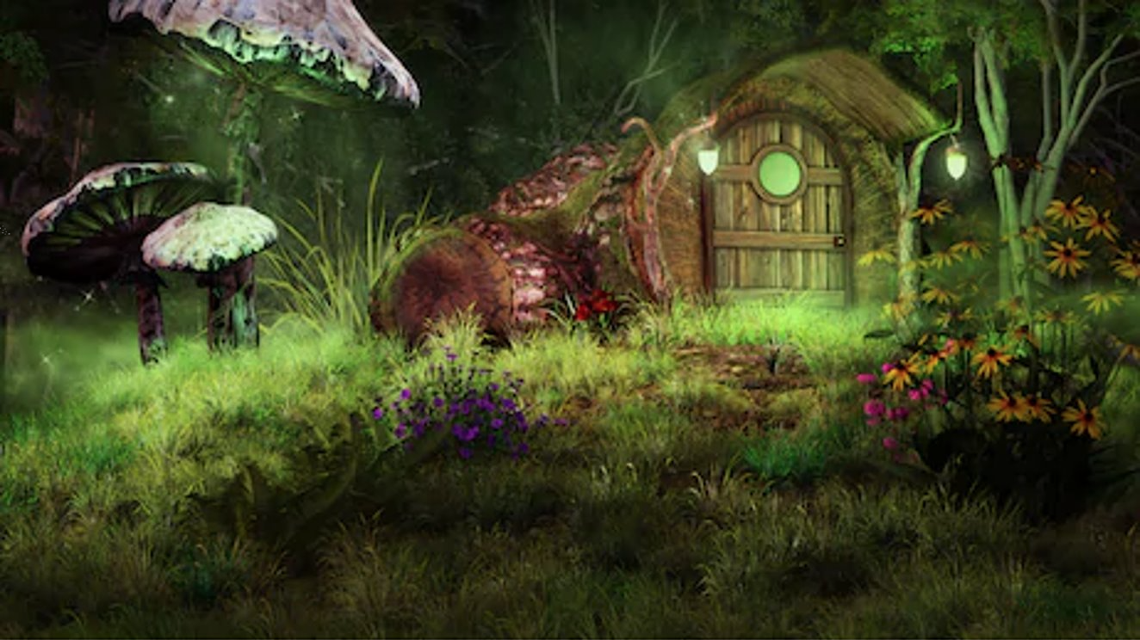

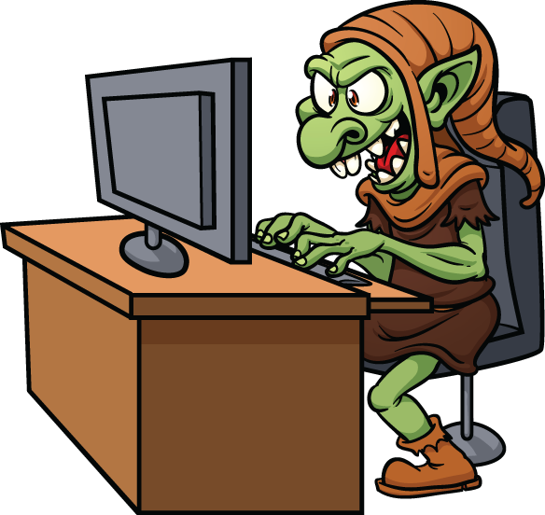
Fairy & The
Trolls
- Insult detection in online discourse

Slide 2


Slide 3


Agenda
Once upon a time…
The Impact & The Challenge
An Insulting Data Dilemma
The Pipeline
To Catch a Troll/Troll Hunting
Key Takeaways
Happily Ever After?...

Slide 4

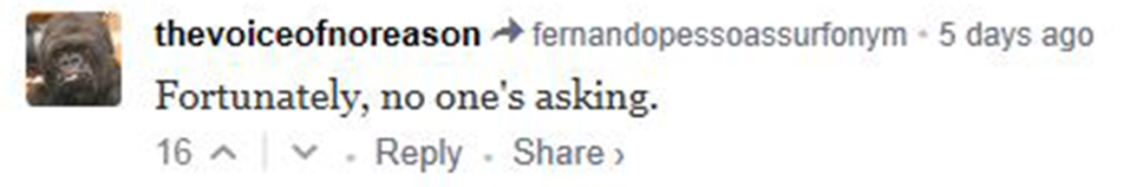
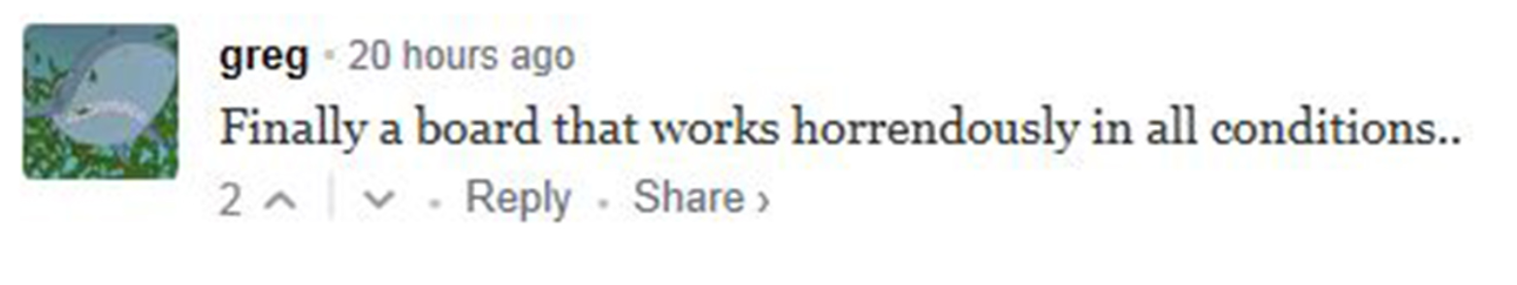
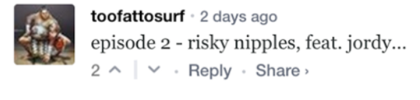
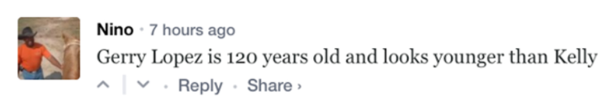
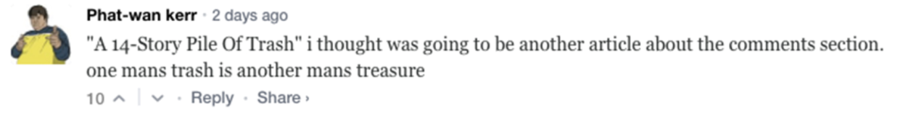
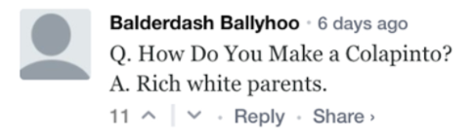
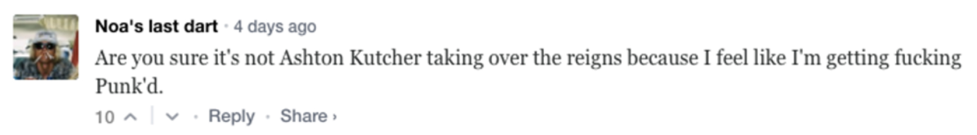
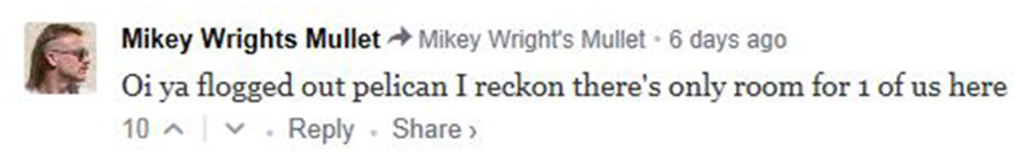
Once upon a time…

Slide 5
Agenda
Once upon a time…
The Impact & The Challenge
An Insulting Data Dilemma
The Pipeline
To Catch a Troll/Troll Hunting
Key Takeaways
Happily Ever After?...

Slide 6
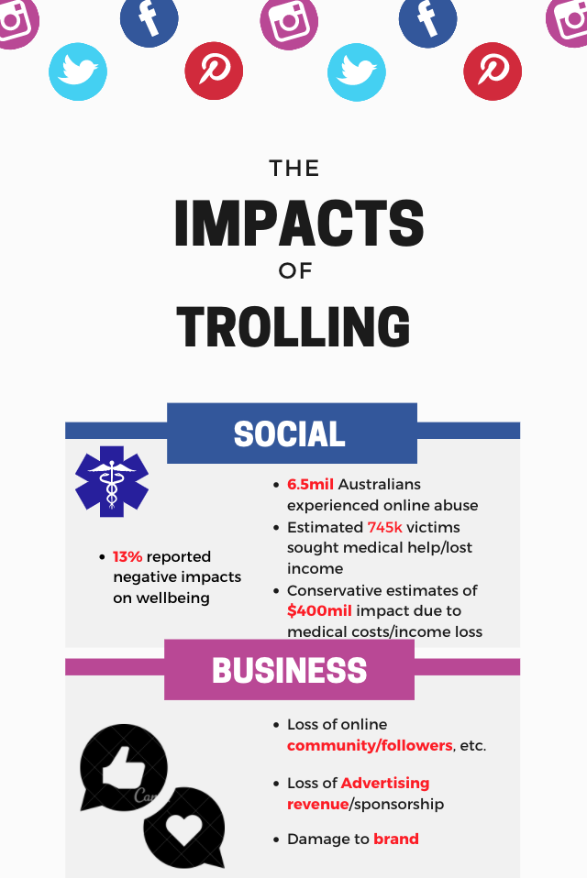
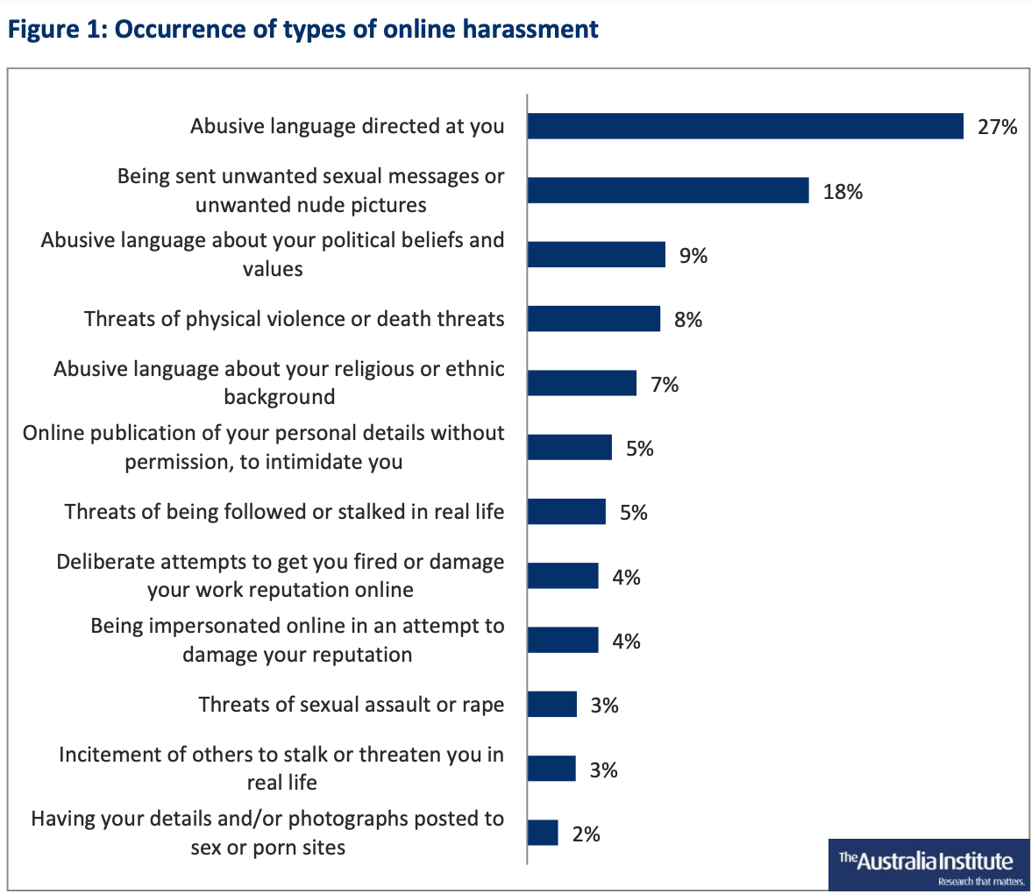
The Impact

Slide 7



The Challenge
Stakeholders
Anyone participating in online social commentary
Business product managers for online media outlets, streaming & social platforms
Business Question
Can we accurately classify insulting remarks directed at an individual subject in online social commentaries so that we may:
Create a space for constructive social discourse
Maintain a low degree of censorship
Data Question
Which pre-processing techniques & feature engineering methods give model the best insight into text data?

Slide 8
Agenda
Once upon a time…
The Impact & The Challenge
An Insulting Data Dilemma
The Pipeline
To Catch a Troll/Troll Hunting
Key Takeaways
Happily Ever After?...

Slide 9
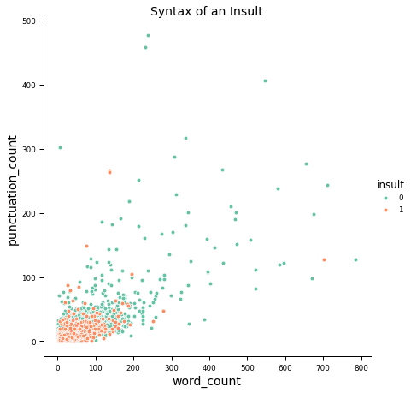
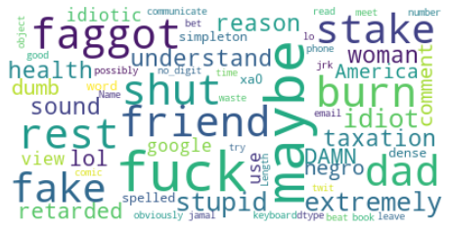
Constructs of an Insult

Slide 10

A Data Dilemma
Comment1: @Dragonoon93 I’m thinking you’re still a\xa0soulless, talentless\\n
hack!!
Comment1: @Dragonoon93 I’m thinking you’re still a\xa0soulless, talentless\\n
hack!!
dragonoon, think, still, soulless, talentless,
hack
 | Dragonoon | think | still | soulless | talentless | hack
Comment1 | 1 | 1 | 1 | 1 | 1 | 1

Slide 11
Agenda
Once upon a time…
The Impact & The Challenge
An Insulting Data Dilemma
The Pipeline
To Catch a Troll/Troll Hunting
Key Takeaways
Happily Ever After?...

Slide 12


The Pipeline
Data
Ingest
Prepare
Feature Engineering
Tokenise
Vectorize
Model & Evaluate
Feed Models
Gauge Performance
Scrape
Tf-idf
BOW
Business Question

Slide 13
Agenda
Once upon a time…
The Impact & The Challenge
An Insulting Data Dilemma
The Pipeline
Troll Hunting
Key Takeaways
Happily Ever After?...

Slide 14

Troll Hunting– The Models
Model Type | Features (BOW/Tf-idf) | Accuracy Score |  | Recall Score |  | ROC AUC
Support Vector Machine (LinearSVC) | BOW | 0.81 | 0.76 | 0.62 | 0.78 | 0.75 | 0.83
 | Tf-idf (Word) | 0.82 | 0.81 | 0.51 | 0.73 | 0.72 | 0.86
 | Tf-idf (n_Grams) | 0.74 | 0.73 | 0.02 | 0.34 | 0.51 | 0.68
 | Tf-idf (Char) | 0.81 | 0.79 | 0.55 | 0.76 | 0.73 | 0.85
Naïve Bayes Multinomial Classifier | BOW | 0.79 | 0.70 | 0.61 | 0.87 | 0.73 | 0.86
 | Tf-idf (Word) | 0.75 | 0.75 | 0.094 | 0.87 | 0.54 | 0.88
 | Tf-idf (n_Grams) | 0.73 | 0.40 | 0.002 | 0.89 | 0.49 | 0.64
 | Tf-idf (Char) | 0.76 | 0.79 | 0.11 | 0.72 | 0.55 | 0.85
Text = Under-sampled training data

Slide 15
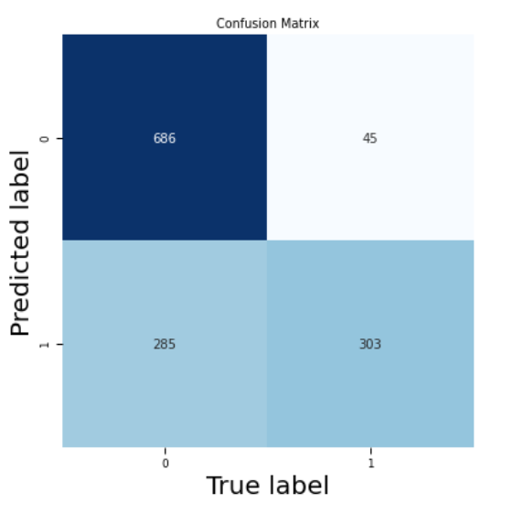
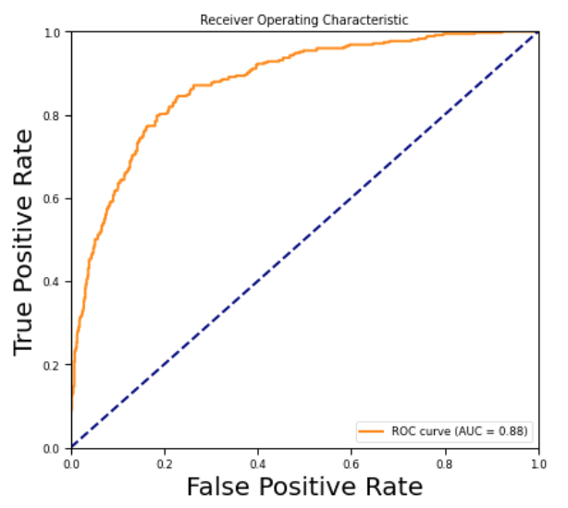
Troll Hunting– The Output

Slide 16
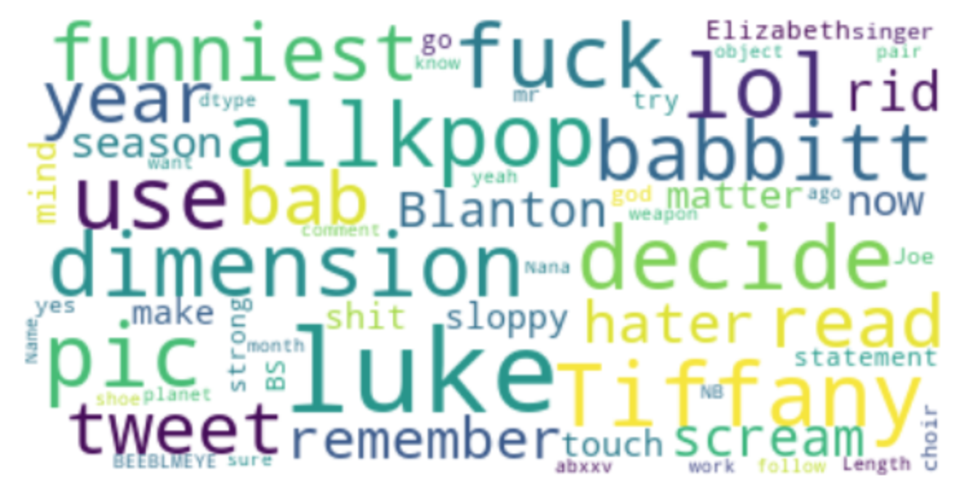
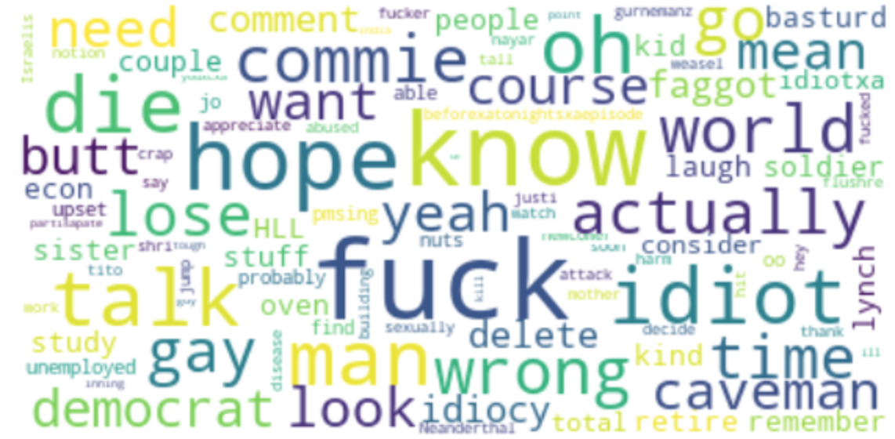
The Ones That Got Away
Correctly Classified Insults
Incorrectly Classified Insults
Notes:
Surprised at how many swearwords remain in the results corpus. What I can think is that these words are so common that Tf-idf weighting was minimal.

Slide 17
Agenda
Once upon a time…
The Impact & The Challenge
An Insulting Data Dilemma
The Pipeline
To Catch a Troll/Troll Hunting
Key Takeaways
Happily Ever After?...

Slide 18

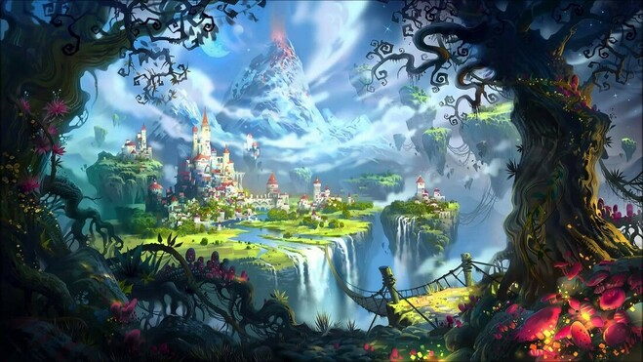

From Imperium Kaggle corpus:
- 6594 comments
- 26% insulting
01
We prepared the data for modelling by:
Stripping noise
Normalizing
Lemmatizing
Tokenizing ++
02
With an under-sampled majority class fed to a Naïve Bayes classifier with Tf-idf unigram features, we obtained an ROC/AUC of 0.88 with maximum recall
03

Slide 19
Happily Ever After?...
The business question:
To accurately identify insulting comments targeted at an individual contributor within an online social commentary whilst minimizing unnecessary censorship
We achieved:
A sound result & relatively strong model
Score-wise, outperformed a similar 2016 Stanford study
Room for improvement:
Quality & quantity of data
Per-platform data scrape
Polling/survey for ‘insult’ / ‘non-insult’ tagging consensus
Improved data engineering
Focus on improving Precision Score
Future work:
Access more comprehensive datasets
Productize model delivery for cloud-based, real-time comment analysis and seed on smaller social platforms

Slide 21
Thank You! Questions?

Slide 22
Thank You! Questions?

Slide 23
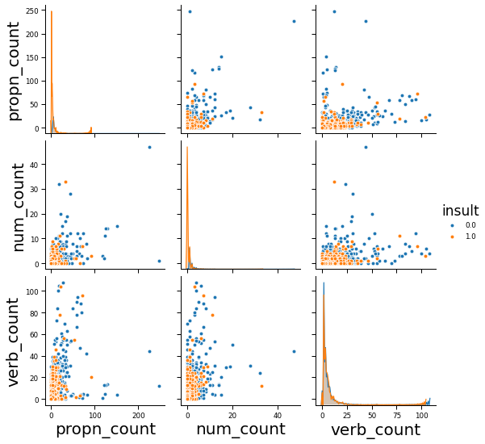
Insults & Parts-of-Speech

